Slide 1
Chapter Three
Data Representation and Computer Arithmetic
• Number Systems and Conversion
• Units of Data Representation
• Coding Methods
• Binary Arithmetic
• Complements
• Fixed and Floating points representation
• (Boolean Algebra) and Logic Circuits
Notes:
Arithmetic : the branch of mathematics dealing with the properties and manipulation of numbers.

Slide 2
Number systems and conversion
• Number Systems
• Decimal
• Binary
• Octal
• Hexadecimal
• Conversion
Notes:
Show how to convert Decimal 1-15 to Binary, to Octal, to Hexadecimal, in a row.

Slide 3
Decimal systems
• The decimal system
Base 10 with ten distinct digits (0, 1, 2, …, 9)
Any number greater than 9 is represented by a combination of these digits
The weight of a digit is based on power of 10
Example:
The number 81924 is actually the sum of:
(8X10⁴)+(1X10³)+(9X10²)+(2X10¹)+(4X10⁰)

Slide 4
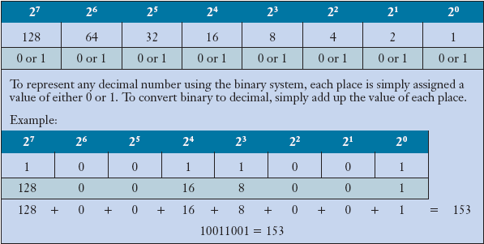
Binary systems
Computers use the binary system to store and compute numbers.

Slide 5
Binary systems
• The binary system (0 & 1)
The two digits representation is called a binary system
Two electrical states – on (1) & off (0)
The position weights are based on the power of 2
The various combination of the two digits representation gives us the final value
Examples :
i) 1011011 in binary = 91 in decimal
ii) 1101.01 in binary = 13.25 in decimal

Slide 6
Binary Fractions
Binary fractions can also be represented:
Position Value: 2⁻¹ 2⁻² 2⁻³ 2⁻⁴ 2⁻⁵ etc.
Fractions: 1/2 1/4 1/8 1/16 1/32
Decimal: .5 .25 .125 .0625 .03125

Slide 7
Binary into Decimal conversion
5th4th3rd2nd1st0th
1 0 1 1 1 1₂ = (1X2⁵)+(0X2⁴)+(1X2³)+(1X2²)+(1X2¹)+(1X2⁰)
= 32+8+4+2+1
= 4710
1011001₂ = 89₁₀
Exercise :
Convert the following binary numbers into their decimal equivalent
• 1110100₂ = (?)₁₀
• 101101.1101₂ = (?)₁₀
Notes:
1110100₂ = 116₁₀
101101.1101₂ = 45.8125₁₀
The base is shown in the subscript.
The raising power is shown in the superscript.

Slide 8
Conversion of Decimal to Binary
Divide by 2 (remainder division) till the dividend is zero and read remainders in reverse order. The right column shows result of integer division
mod 2 637/2
1 318
0 159
1 79
1 39
1 19
1 9
1 4
0 2
0 1
1 0
Read answer in this direction, Write answer left to right
637₁₀ = 1001111101 ₂
Convert 789₁₀ to base 2
Notes:
Divide the right side by 2 (integer division) and write the result, write the remainder at the left.
Show Remainder division 637 % 2 = 1 and Integer division 637 / 2 = 318
Using python, print (637%2) = 1, and int (637 / 2) = 318
789₁₀ = 1100010101₂
Can you write this in C++?
We can use the same technique for other bases.
637₁₀ = 27D₁₆ = 1175₈ Check this using the same technique used here!

Slide 9
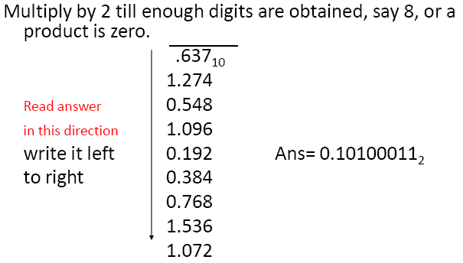
To Binary Fractions - Conversions
Convert 0.325₁₀ to base 2
Notes:
If we convert the result back to decimal fraction, we might get little
difference depending on the number of bit precision we have decided to use.
That is, the answer 0.10100011₂ = 0.63671875₁₀ for 0.637;
0.325₁₀ = 0.01010011₂

Slide 10
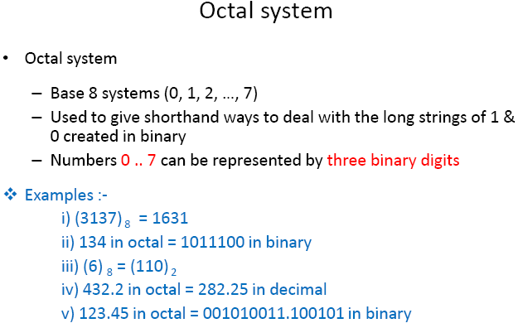
10

Slide 11
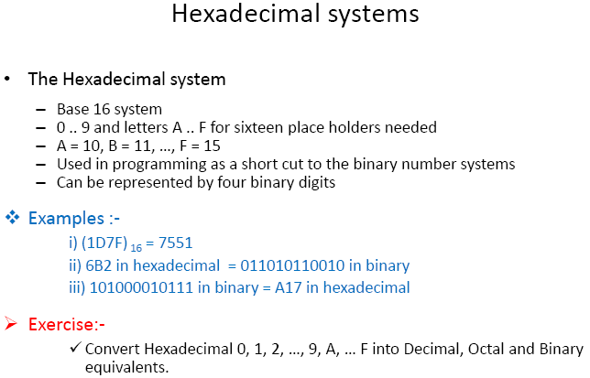
10

Slide 12
Exercise – Convert ...
Decimal | Binary | Octal | Hexa- decimal
29.8
 | 101.1101
 |  | 3.07
 |  |  | DF.E8
Notes:
DF.E8 = (13*16 + 15 + 14/16 + 8/(16*16))₁₀ = 223.90625₁₀

Slide 13
Exercise – Convert …
Answer
Decimal | Binary | Octal | Hexa- decimal
29.8 | 11101.110011… | 35.63… | 1D.CC…
5.8125 | 101.1101 | 5.64 | 5.D
3.109375 | 11.000111 | 3.07 | 3.1C
12.5078125 | 1100.10000010 | 14.404 | C.82

Slide 14
Storage Memory Bits
How many bits does a computer use to store an integer?
Some models = 32 bits
Other models = 64 bits
What if we try to compute or store a larger integer?
If we try to compute a value larger than the computer can store, we get an arithmetic overflow error.
Notes:
Show overflow by adding two unsigned four bit numbers: 1111 + 0101, for example
Underflow is a condition which occurs in a computer or similar device when a mathematical operation
results in a number which is smaller than what the device is capable of storing. ...
Similar to overflow, underflow can cause significant errors.

Slide 15
Representing Unsigned Integers
How does a 16-bit computer represent the value 14?
What is the largest 16-bit integer?
0 | 0 | 0 | 0 | 0 | 0 | 0 | 0 | 0 | 0 | 0 | 0 | 1 | 1 | 1 | 0
1 | 1 | 1 | 1 | 1 | 1 | 1 | 1 | 1 | 1 | 1 | 1 | 1 | 1 | 1 | 1
= 1x2¹⁵ + 1x2¹⁴ + … + 1x2¹ + 1x2⁰ = 65,535
If we just add 1 to this number, for example, overflow will occur. We will get a wrong result.
Notes:
For unsigned integer representation : 0 up to 2^{n} – 1 are represented using n bits memory.
Demonstrate overflow using code blocks and int datatype! (Signed)
Also show them tracing (Debugging).
[QQ] You can try overflow for unsigned int!

Slide 16
Representing Signed Integers
How does a 16 bit computer represent the value -14?
What is the largest 16-bit signed integer?
1 | 0 | 0 | 0 | 0 | 0 | 0 | 0 | 0 | 0 | 0 | 0 | 1 | 1 | 1 | 0
Sign bit. 0: + (positive), 1: - (negative)
0 | 1 | 1 | 1 | 1 | 1 | 1 | 1 | 1 | 1 | 1 | 1 | 1 | 1 | 1 | 1
= 1x2¹⁴ + 1x2¹³ + … + 1x2¹ + 1x2⁰ = 32,767
Problem ➔ the value 0 is represented twice!
Most computers use a different representation, called two’s complement.
Notes:
Negative zero and positive zero;
0000000000000000 and 1000000000000000
-2^{n-1} – 1 upto 2^{n-1} – 1 are represented. (Sign and Magnitude Representation)
-2¹⁵ – 1 upto 2¹⁵ – 1 are represented using 16 bits storage space. (Sign and Magnitude Representation)
Use code blocks for overflow demonstration.
2³¹ – 1 = 2147483647
-2³¹ = – 2147483648

Slide 17
Signed-magnitude representation
Also called, “sign-and-magnitude representation”
A number consists of a magnitude and a symbol representing the sign
Usually 0 means positive, 1 negative
Sign bit
The number is represented with 1 sign bit to the left, followed by magnitude bits

Slide 18
Machine arithmetic with signed-magnitude representation
Takes several steps to add a pair of numbers
Examine signs of the addends
If same, add magnitudes and give the result the same sign as the operands
If different, must…
Compare magnitude of the two operands
Subtract smaller number from larger
Give the result the sign of the larger magnitude operand
If magnitudes are equal and sign is different; two representations of zero problem
For this reason the signed-magnitude representation is not as popular as one might think because of its “naturalness”
Notes:
Negative zero and positive zero;
0000000000000000 and 1000000000000000
Remember the first bit is a sign bit!

Slide 19
Complement number systems
Negates a number by taking its complement instead of negating the sign
Not natural for humans, but better for machine arithmetic
Will describe 2 complement number systems
Radix complement – very popular in real computers
Must first decide how many bits to represent the number – say n.
Complement of a number = r^{n} – number
Example: 2’s Complement
Diminished radix-complement – not very useful, may skip it or not spend much time on it
Example: 1’s Complement: r^{n} - number - 1
Notes:
Show them using 7 in 4 bits. Thus, 7 = 0111 both in 2’s complement and Sign and Magnitude.
But, -7 = 1111 in Sign and Magnitude; and -7 = 2⁴ - 0111 = 10000 – 0111 = 1001 in 2’s Complement.
Or simply flip all bits and add 1 to get the 2’s complement of a number.
Radix is the base of the number system.
For example, the radix complement of 99 in base 10 is 10² – 99 = 1;
1’s complement = r^{n} - number – 1 = 2’s complement -1 = or simply flip the bits with out adding 1

Slide 20
Two’s-complement representation
Just radix-complement when radix = 2
The most used representation of integers in computers and other digital arithmetic circuits
0 and positive numbers: leftmost bit = 0
Negative numbers: leftmost bit = 1
Representation of zero
i.e. 0 is represented as 0000 using 4-bit binary sequence.
To find a number’s 2’s-complement – just flip all the bits and add 1

Slide 21
Properties of Two’s Complement Notation
Relationship between +n and –n.
0 1 0 0 +4 0 0 0 1 0 0 1 0 +18
1 1 0 0 -4 1 1 1 0 1 1 1 0 -18

Slide 22
Two’s Complement Notation with 4-bits
Binary Pattern
Value in 2’s complement.
0 1 1 1 7
0 1 1 0 6
0 1 0 1 5
0 1 0 0 4
0 0 1 1 3
0 0 1 0 2
0 0 0 1 1
0 0 0 0 0
1 1 1 1 -1
1 1 1 0 -2
1 1 0 1 -3
1 1 0 0 -4
1 0 1 1 -5
1 0 1 0 -6
1 0 0 1 -7
1 0 0 0 -8
Notes:
Using n bits, -2^{n-1} upto 2^{n-1} – 1 are represented.

Slide 23
Advantages of Two’s Complement Notation
It is easy to add two numbers.
0 0 0 1 +1 1 0 0 0 -8
0 1 0 1 +5 0 1 0 1 +5
+
+
0 1 1 0 +6 1 1 0 1 -3
Subtraction is 2’s complement addition
Multiplication is just a repeated addition
Division is just a repeated 2’s complement addition
Two’s complement is widely used in ALU
Notes:
16/4 : 16 – 4 – 4 – 4 – 4 = 0 ; Count the # of subtracted 4s (devisor) and that will be the result.
Remember, subtraction is two’s complement addition.
4 * 4 = Adding 4, four times;

Slide 24
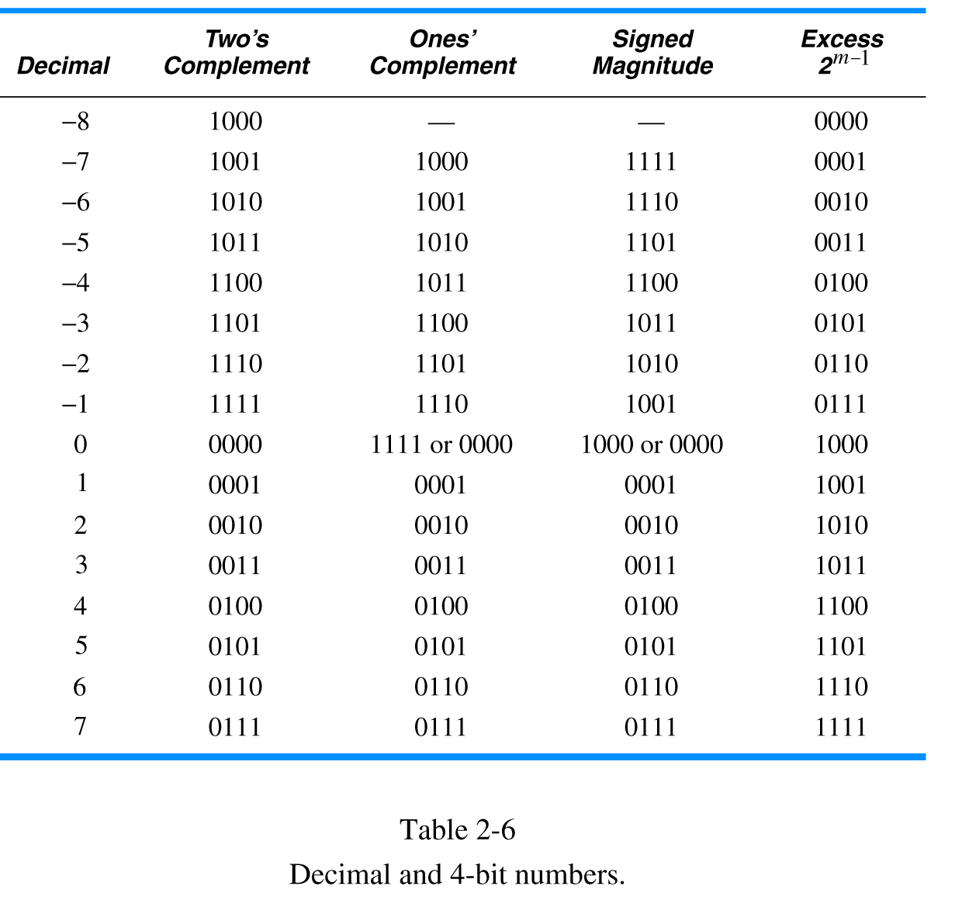
Comparison of decimal and 4-bit numbers Complements and other Notations
Excess is 2⁴⁻¹ = 8; Thus, retrieved value=stored value-8
Decimal numbers, their two’s complements, ones’ complements, signed magnitude and excess 2^{m-1} binary codes
EXPLAIN
XXXXXXXXXXXXXXXXXXXXXXXXXX
Existence of two zeros!
Notes:
In Excess notation, we read the value as unsigned number.
Then we subtract the excess value to get the actual value.

Slide 25
Two’s-Comp Addition and Subtraction Rules
Starting from 1000 (-8) on up, each successive 2’s comp number all the way to 0111 (+7) can be obtained by adding 1 to the previous one, ignoring any carries beyond the 4th bit position
Since addition is just an extension of ordinary counting, 2’s comp numbers can be added by ordinary binary addition!
No different cases based on operands’ signs!
Overflow possible
Occurs if result is out of range
if operands are the same sign but sum is a different sign of that of the operands, overflow has occurred.
Notes:
Use previous slide (slide 24) or slide 22 to explain this by adding 1 starting from -8 (1000);
With 4 bits, 7 (0111) plus 1 (0001) is overflow because the result’s sign is different from the sign of the addends (operands);

Slide 26
Storing an integer in two’s complement format:
Convert the integer to an n-bit binary.
If it is positive or zero, it is stored as it is. If it is negative, take the two’s complement and then store it.
Retrieving an integer in two’s complement format:
If the leftmost bit is 1, the computer applies the two’s complement operation to the n-bit binary. If the leftmost bit is 0, no operation is applied.
The computer changes the binary to decimal (integer) and corresponding sign is added.

Slide 27
Example:
Retrieve the integer that is stored as 11100110 in memory using two’s complement format.
Solution:
The leftmost bit is 1, so the integer is negative. The integer needs to be two’s complemented before changing to decimal.

Slide 28
Comparison
XXXXXXXXX

Slide 29
STORING REAL NUMBERS
A number is changed to binary before being stored in computer memory, as described earlier. There are two issues that need to be handled:
How to store the sign of the number (we already know this).
How to show the (radix) point.
For the (radix) point, computers use two different representations: fixed-point and floating-point. The first is used to store a number as an integer, without a fraction part. The second is used to store a number as a real number, with a fractional part.
Notes:
The radix point is an assumed position that divides the whole and the fractional parts of a real number.

Slide 30
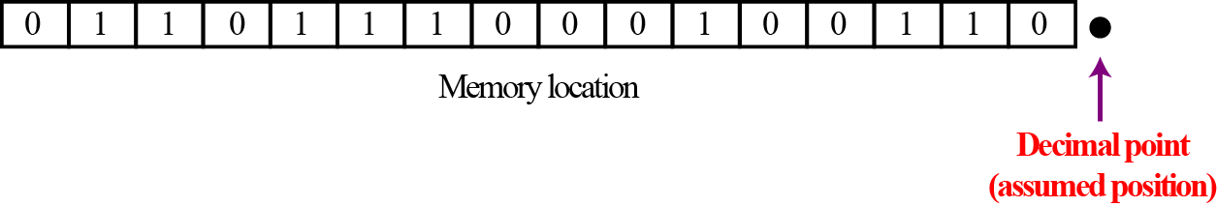
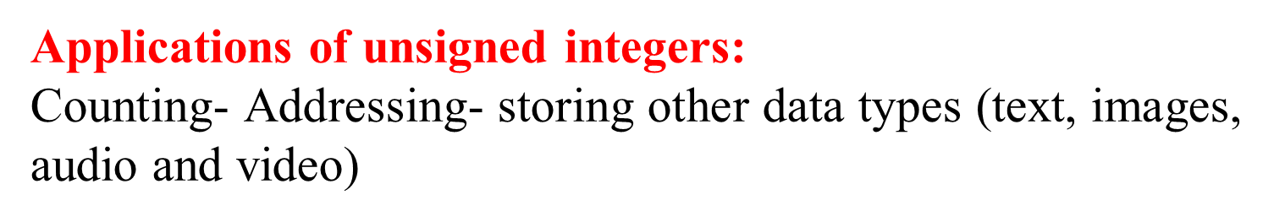
/Radix point
Fixed point representation of integers
An integer is normally stored in memory using fixed-point representation.
Notes:
Floating point representation is used for very large and very small real number representation
Text in computer memory is stored (encoded) using integers.

Slide 31
Storing real numbers Continued
A real number is a number with an integral part and a fractional part. For example, 23.7 is a real number—the integral part is 23 and the fractional part is 7/10. Although a fixed-point representation can be used to represent a real number, the result may not be accurate or it may not have the required precision. The next two examples explain why.
Real numbers with very large integral parts or very small fractional parts should not be stored in fixed-point representation.

Slide 32
Example 1:
In the decimal system, assume that we use a fixed-point representation with two digits to the right of the decimal point and fourteen digits to the left of the decimal point, for a total of sixteen digits. The precision of a real number in this system is lost if we try to represent a decimal number such as 1.00234: the system stores the number as 1.00
Example 2:
In the decimal system, assume that we use a fixed-point representation with six digits to the right of the decimal point and ten digits to the left of the decimal point, for a total of sixteen digits. The accuracy of a real number in this system is lost if we try to represent a decimal number such as 236154302345.00 The system stores the number as 6154302345.00 The integral part is much smaller than it should be.
Notes:
Here we assume fixed point representation, which is not the case in actual use.

Slide 33
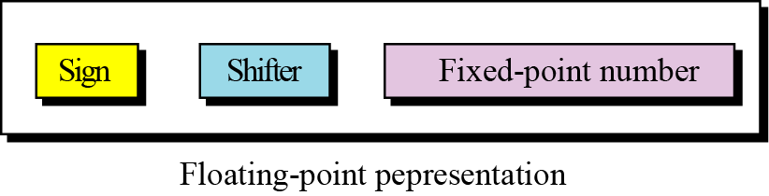
Floating-point representation
The solution for maintaining accuracy or precision is to use floating-point representation.
A floating point representation of a number is made up of three parts: a sign, a shifter and a fixed-point number.
Floating-point representation is used in science to represent very small or very large decimal numbers. In this representation called scientific notation, the fixed-point section has only one digit to the left of point and the shifter is the power of 10.
Notes:
For example, +9.65 x 10³⁴

Slide 34
Example:
The following shows the decimal number
7,425,000,000,000,000,000,000.00
in scientific notation (floating-point representation).
The three sections are the sign (+), the shifter (21) and the fixed-point part (7.425). Note that the shifter is the exponent.
Some programming languages and calculators shows the number as +7.425E21

Slide 35
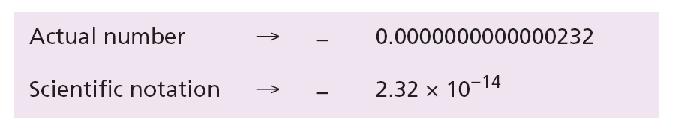
Example:
Show the number
−0.0000000000000232
in scientific notation (floating-point representation).
Solution We use the same approach as in the previous example—we move the decimal point after the digit 2, as shown below:
The three sections are the sign (−), the shifter (−14) and the fixed-point part (2.32). Note that the shifter is the exponent.

Slide 36
Example:
Show the number,
(101001000000000000000000000000000.00)₂
in floating-point representation.
Solution We use the same idea, keeping only one digit to the left of the radix (decimal) point.

Slide 37
Example:
Show the number
−(0.00000000000000000000000101)₂
in floating-point representation.
Solution We use the same idea, keeping only one digit to the left of the decimal point.

Slide 38
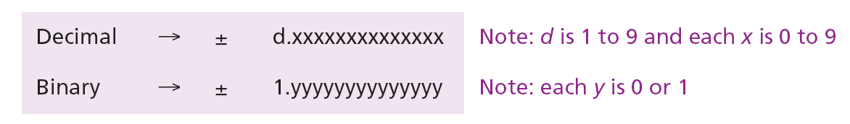
Normalization
To make the fixed part of the representation uniform, both the scientific method (for the decimal system) and the floating-point method (for the binary system) use only one non-zero digit on the left of the decimal point. This is called normalization. In the decimal system this digit can be 1 to 9, while in the binary system it can only be 1. In the following, d is a non-zero digit, x is a digit, and y is either 0 or 1.

Slide 39
To store 1000111.0101₂ in memory, using floating point representation; First we put it in normalized form 1.0001110101 * 2⁶ , and then store it as shown below
Note that the point and the bit 1 to the left of the fixed-point section (Mantissa) are not stored; They are implicit (hidden or not shown).
Notes:
We want to store 1000111.0101 in memory.
Using floating point representation, it equals to 1.0001110101 * 2⁶
Sign is + or 0, Exponent or Shifter is 6, and Fixed point part or Mantissa is 0001110101

Slide 40
Excess Notation
The exponent, the power that shows how many bits the decimal point should be moved to the left or right, is a signed number.
Although this could have been stored using two’s complement representation, a new representation, called the Excess notation, is used instead.
In the Excess notation, both positive and negative integers are stored as unsigned integers.
To represent a positive or negative integer, a positive integer (called a bias) is added to each number to shift them uniformly to the non-negative side. The value of this bias is 2^{m-1} - 1, where m is the size of the memory to store the exponent.

Slide 41
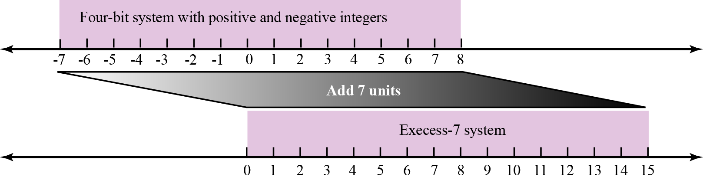
Example:
We can express sixteen integers in a number system with 4-bit allocation. By adding seven units to each integer in this range, we can uniformly translate all integers to the right and make all of them positive without changing the relative position of the integers with respect to each other, as shown in the figure. The new system is referred to as Excess-7, or biased representation with biasing value of 7.
Shifting in Excess representation

Slide 42
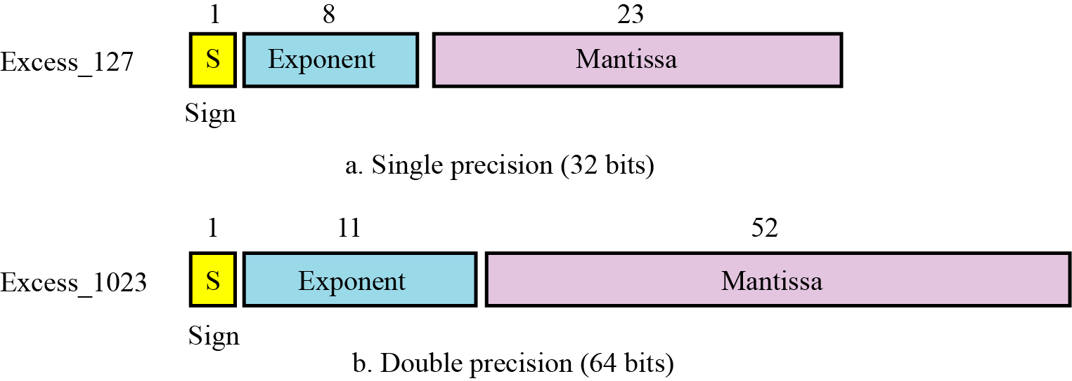
IEEE Standard
IEEE standards for floating-point representation
Notes:
IEEE: Institute for Electrical and Electronic Engineers
Developed in response to divergence of representations
Portability issues for scientific code
Now almost universally adopted

Slide 43
IEEE Specifications
XXXXXX
Storage of IEEE standard floating point numbers:
Store the sign in S (0 or 1).
Change the number to binary.
Normalize.
Find the values of E and M.
Concatenate S, E, and M.
Notes:
Normalize : Put it in scientific notation in base 2!

Slide 44
Example 1:
Show the Excess_127 (single precision) representation of the decimal number 5.75
Solution
The sign is positive, so S = 0.
Decimal to binary transformation: 5.75 = (101.11)₂.
Normalization: (101.11)₂ = (1.0111)₂ × 2².
E = 2 + 127 = 129 = (10000001)₂, M = 0111. We need to add nineteen zeros at the right of M to make it 23 bits.
The representation is shown below:
01110000000000000000000
The number is stored in the computer as
01000000101110000000000000000000
Notes:
This value in hexadecimal equals to : 40b80000
All bits zero and All bits one (for the exponent), is not allowed, it is NaN.
Can zero(0) be represented in this numbering scheme? How?

Slide 45
Example 2:
Show the Excess_127 (single precision) representation of the decimal number –161.875
Solution
The sign is negative, so S = 1.
Decimal to binary transformation: 161.875= (10100001.111)₂.
Normalization: (10100001.111)₂ = (1.0100001111)₂ × 2⁷.
E = 7 + 127 = 134 = (10000110)₂ and M = (0100001111)₂.
Representation:
The number is stored in the computer as
110000110010000111100000000000000
Notes:
This value in hex equals to : c321e000
All bits zero and All bits one (for the exponent), is not allowed, it is NaN.
Can zero(0) be represented here? How?

Slide 46
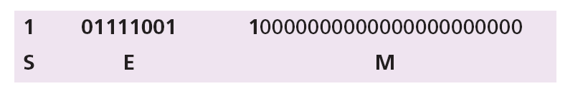
Example 3:
Show the Excess_127 (single precision) representation of the decimal number –0.0234375
Solution
S = 1 (the number is negative).
Decimal to binary transformation: 0.0234375 = (0.0000011)₂.
Normalization: (0.0000011)₂ = (1.1)₂ × 2⁻⁶.
E = –6 + 127 = 121 = (01111001)₂ and M = (1)₂.
Representation:
The number is stored in the computer as
10111100110000000000000000000000
Notes:
This value in hex equals to : bcc00000
All bits zero and All bits one (for the exponent), is not allowed, it is NaN.
Can zero(0) be represented in this numbering scheme? How? Answer is on following slides.

Slide 47
Retrieving numbers stored in IEEE standard floating point format:
Find the value of S,E, and M.
If S=0, set the sign to positive, otherwise set the sign to negative.
Find the shifter (E-127).
De-normalize the mantissa.
Change the de-normalized number and find the absolute value (in decimal).
Add sign.

Slide 48
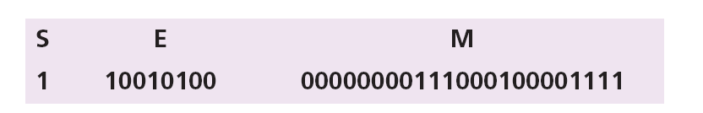
Example 4:
The bit pattern (11001010000000000111000100001111)₂ is stored in Excess_127 format, in memory. Show the retrieved value in decimal.
Solution
The first bit represents S, the next eight bits, E and the remaining 23 bits, M.
The sign is negative.
The shifter = E − 127 = 148 − 127 = 21.
This gives us (1.00000000111000100001111)₂ × 2²¹
The binary number is (1000000001110001000011.11)₂
The absolute value is 2,104,387.75
The number is −2,104,387.75
Notes:
Storing Zero:
A real number with an integral part and the fractional part set to zero, that is, 0.0, cannot be stored using the steps discussed above. To handle this special case, it is agreed that in this case the sign, exponent and the mantissa are set to 0s.

Slide 49
Example 5
Single precision
0 10000010 11000000000000000000000
1.11₂
130 – 127 = 3
0 = positive mantissa
+1.11₂ x 2³ = 1110.0₂ = 14.0₁₀

Slide 50
Exercise
Represent +0.8 in the following floating-point representation:
1-bit sign
4-bit exponent
6-bit normalised mantissa (significand).
Convert the value represented back to decimal.
Calculate the relative error of the representation.
Notes:
Significand: Significant Digits (all the bits including the implicit 1 before the radix point)
0.8₁₀ = 0.110011₂ = 1.10011 * 2⁻¹ => E= -1+7; Where Excess = 2⁴⁻¹ - 1;
Thus, the answer to (1) is : 0 0110 100110; (2) is : 0.796875; (3) is : 0.003125
Relative error = (0.8 – 0.796875)/0.796875; We can also put this in percent by multiplying it by 100%
0.8 – 0.796875 is absolute error

Slide 51
Binary Codes
Computers also use binary numbers (integers) to represent non-numeric information, such as text or graphics (images).
Binary representations of text, (letters, textual numbers, punctuation symbols, etc.) are called codes.
In a binary code, the binary number is a symbol and does not represent an actual number.
A code normally cannot be “operated on” in the usual fashion – mathematical, logical, etc. That is, one can not usually add up, for example, two binary codes. It would be like attempting to add text and graphics!
Notes:
Coding is the process of altering the characteristics of information to make it more suitable for intended application (storage or transmission).
Decoding is the process of reconstructing (source) information from the encoded information.
Text = Alphanumeric and Non-alphanumeric characters
= Alphabets, numeric characters, non-alphanumeric characters (engineering symbols, emoji symbols, etc.)
= Technical notations (symbols)

Slide 52
Character representation- ASCII
ASCII (American Standard Code for Information Interchange) - Binary Codes
It is the scheme used to represent characters.
Each character is represented using 7-bit binary code.
If 8-bits are used, the first bit is always set to 0
Notes:
Letters of the Latin-1 Supplement: U+00C0 – U+00FF
Morse Code!

Slide 53
Numeric and Alphabetic Codes
ASCII code
American Standard Code for Information Interchange
an alphanumeric code
each character represented by a 7-bit code
gives 128 possible characters
codes defined for upper and lower-case alphabetic characters, digits 0 – 9, punctuation marks and various non-printing control characters (such as carriage-return and backspace)
Notes:
Alphanumeric and Non Alphanumeric Codes

Slide 54
ASCII – examples
Symbol decimal Binary
7 55 00110111
8 56 00111000
9 57 00111001
: 58 00111010
; 59 00111011
< 60 00111100
= 61 00111101
> 62 00111110
? 63 00111111
@ 64 01000000
A 65 01000001
B 66 01000010
C 67 01000011
Notes:
Use the Code-blocks Debugger to demonstrate content in memory!
To trace a source code (to debug), it has to be in a project.

Slide 55
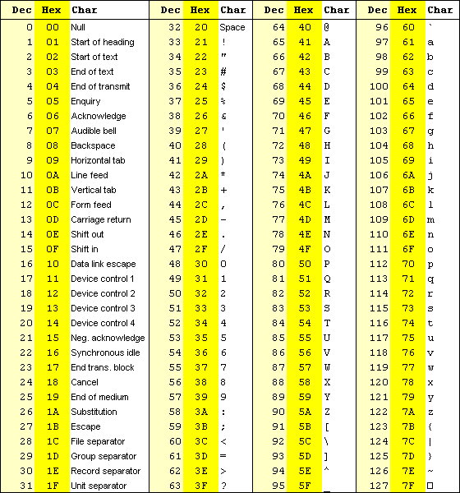
Notes:
In C++ use, cout << char(7); to hear the audible sound.

Slide 56
Representation schemes:
Top layers - Character string to character sequence: Write each letter separately, enclosed in quotes. End string with ‘\0’.
Notation: enclose strings in double quotes
"Hello world"
Bottom layer - Character to bit-string: Represent a character using the binary equivalent according to the ASCII table provided.
'H' 'e' 'l' 'l' 'o' ' ' 'W' 'o' 'r' 'l' 'd' '\0'
"SI"
'S' 'I' '\0'
010100110100100100000000
The colors are intended to help you read it; computers don’t care that all the bits run together.
Notes:
Mapping or Lookup table is used between these layers (at least).
Please put this in its hexadecimal equivalent.
NEED TO PROVIDE PRINTED ASCII TABLES
Use Code Blocks debugger to demonstrate this situation!
To trace a source code (to debug it), it has to be in a project.

Slide 57
exercise
Use the ASCII table to write the ASCII code for the following string of characters:
CIS110
6=2*3
Write your name in hexadecimal.
Notes:
Demonstration of C++ debugger can also go here!

Slide 58
Unicode - representation
ASCII code can represent only 128 = 2⁷ characters.
It only represents the English Alphabet, numeric characters, few other characters plus some control characters.
Unicode is designed to represent the worldwide printable and non printable characters.
It uses 32 bits and can represent 2³² characters.
For compatibility, the first 128 Unicode are the same as that of the ASCII characters.
Notes:
The first 256 codes follow precisely the arrangement of ISO/IEC 8859-1 (Latin 1), of which 7-bit ASCII (ISO/IEC 646 IRV) accounts for the first 128 code positions.
0000-00FF ASCII & Latin-1 Compatibility Area

Slide 59
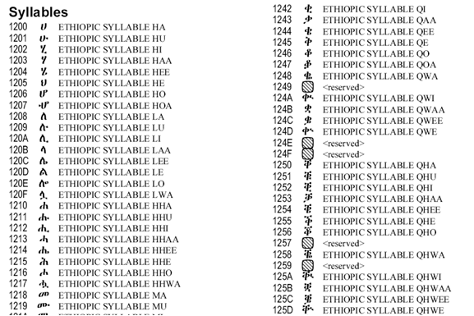
Unicode cont’d..
Let’s consider how Ethiopia’s character sets are represented
The character set is called Ethiopic
Range: 1200-1378 (in hexadecimal)
Example character sets
Notes:
chr (0x1200) = Ha in Amharic, 0x for hex; 0o for oct; 0b for binary; nothing for decimal
Amharic from 4608 – 4988 in decimal.
print (chr(0x1200)) in Python.

Slide 60
exercise
Use UNICODE character representation to write the following:
G G< H> H H@ I J

Slide 61
Boolean Algebra & Digital Logic
Boolean algebra is a mathematical system for the manipulation of variables that can have one of two values.
In formal logic, these values are “true” and “false.”
In digital systems, these values are “on” and “off,” 1 and 0, or “high” and “low.”
Boolean expressions are created by performing operations on Boolean variables.
(Common Boolean operators include AND, OR, and NOT.)
one unary operator “not” (symbolized by an over bar), two binary operators "+" and "."
Notes:
Abstraction: the quality of dealing with ideas rather than events.
: the quality or process of treating something in theoretical way.
: something which exists only as an idea
synonyms: concept, idea, notion, thought, generality, generalization, theory, theorem, formula,
hypothesis, speculation, conjecture, supposition, presumption
Expression : a collection of symbols that jointly express a quantity.
"the expression for the circumference of a circle is 2πr"
Logic : reasoning conducted or assessed according to strict principles of validity.
"experience is a better guide to this than deductive logic"

Slide 62
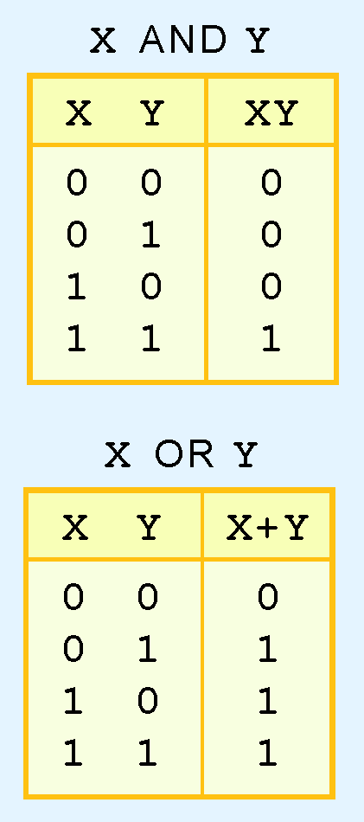
Boolean Algebra
A Boolean operation can be completely described using a truth table.
The truth table for the Boolean operators AND and OR are shown at the right.
The AND operation is also known as a Boolean product. The OR operation is the Boolean sum.
Notes:
X AND Y = X.Y; X OR Y = X + Y
Show examples using switches and lamps.
Show them the electrical circuit equivalent.

Slide 63
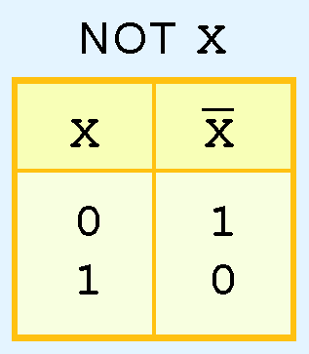
Boolean Algebra
The truth table for the Boolean NOT operator is shown at the right.
The NOT operation is most often designated by an overbar. It is sometimes indicated by a prime mark ( ‘ ) or an “elbow” (¬).
Notes:
Unary operator
The NOT gate is an inverter. (It may not be negate)
Show them the electrical circuit equivalent.

Slide 64
Boolean Algebra
A Boolean function has:
At least one Boolean variable,
At least one Boolean operator, and
At least one input from the set {0,1}.
It produces an output that is also a member of the set {0,1}.
Most modern programming Languages include the Boolean data type.
Notes:
This possibly will indicate why the binary numbering system is so handy in digital systems.

Slide 65
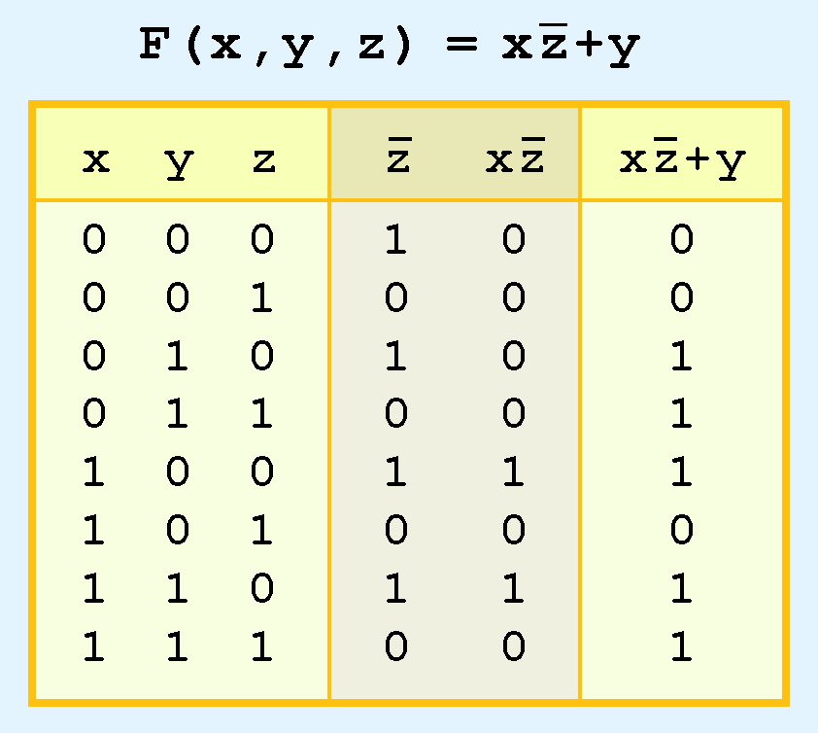
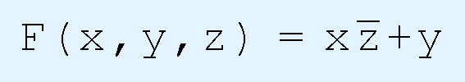
Boolean Algebra
The truth table for the Boolean function:
is shown at the right.
To make evaluation of the Boolean function easier, the truth table contains extra (shaded) columns to hold evaluations of subparts of the function.
Notes:
Function : a relation or expression involving one or more variables. "the function (bx + c)"
a variable quantity regarded in relation to one or more other variables in terms of which it may be
expressed or on which its value depends. "the magnetic field has varied as a function of time"
Most modern programming Languages include the Boolean data type.
** Students asked me about precedence. I think operation precedence has no relevance here (We don’t go that far)!
(Nahom Alemayehu)

Slide 66
Logic Gates
We have looked at Boolean functions in abstract terms.
In this section, we see that Boolean functions are implemented in digital computer circuits called gates.
A gate is an electronic device that produces a result based on two or more input values.
In reality, gates consist of one to six transistors, but digital designers think of them as a single unit.
Integrated circuits contain collections of gates suited to a particular purpose.
Notes:
Abstraction: the quality of dealing with ideas rather than events.
: the quality or process of treating something in theoretical way.
: something which exists only as an idea
synonyms: concept, idea, notion, thought, generality, generalization, theory, theorem, formula,
hypothesis, speculation, conjecture, supposition, presumption
Modelling and Implementation
Modelled using symbols and Implemented using electronics

Slide 67
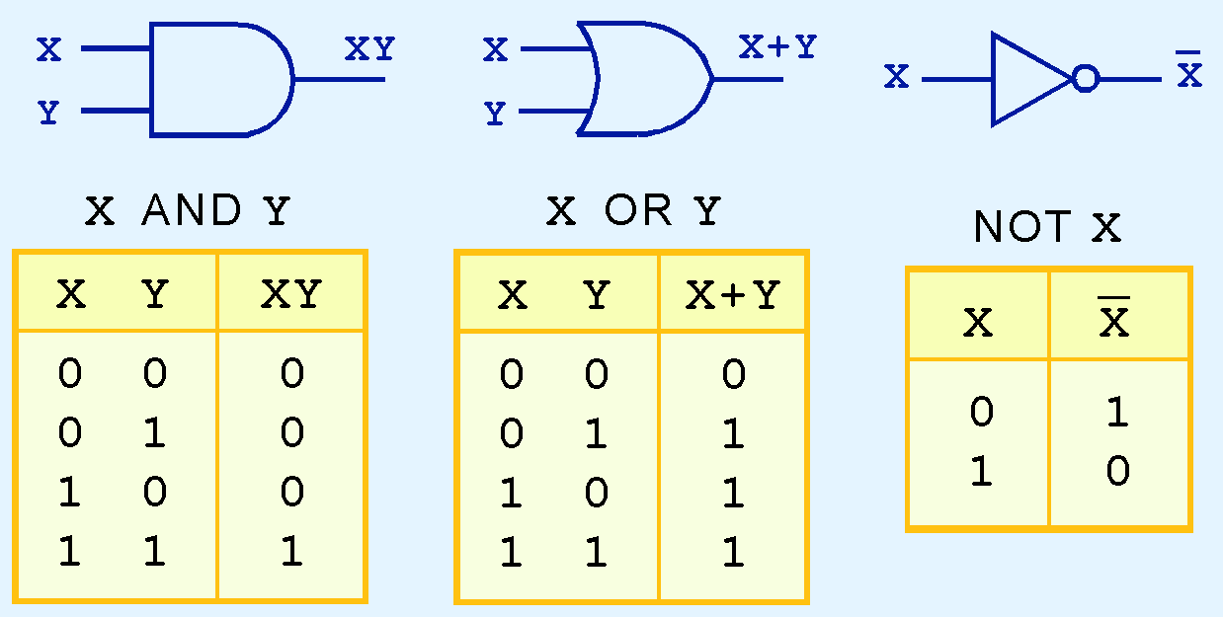
Logic Gates
The three simplest gates are the AND, OR, and NOT gates.
They correspond directly to their respective Boolean operations, as you can see by their truth tables.

Slide 68
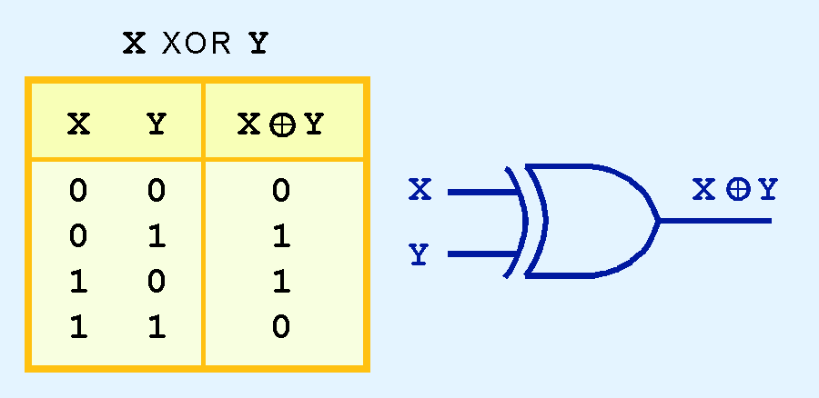
Logic Gates
Another very useful gate is the exclusive OR (XOR) gate.
The output of the XOR operation is true only when the values of the inputs differ.
Note the special symbol ⊕ for the XOR operation.
Notes:
F(x,y) = xy’ + x’y
Draw the logic circuit for XOR
Draw the logic circuit for the function F(x,y,z) = xz’ + y

Slide 69
Adders
At the digital logic level, addition is performed in binary
Addition operations are carried out by special circuits called, appropriately, adders

Slide 70
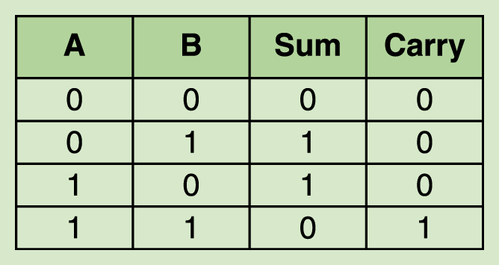
Adders
The result of adding two binary digits could produce a carry value
Recall that 1 + 1 = 10 in base two
A circuit that computes the sum of two bits and produces the correct carry bit is called a half adder
Notes:
This is the truth table for the half adder, A + B

Slide 71
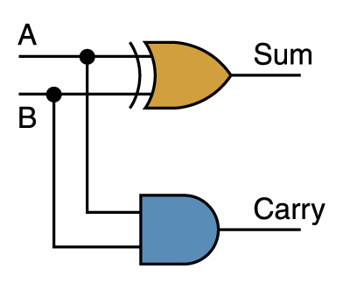
Adders
Circuit diagram representing a half adder
Two Boolean expressions:
sum = A ⊕ B
carry = AB

Slide 72
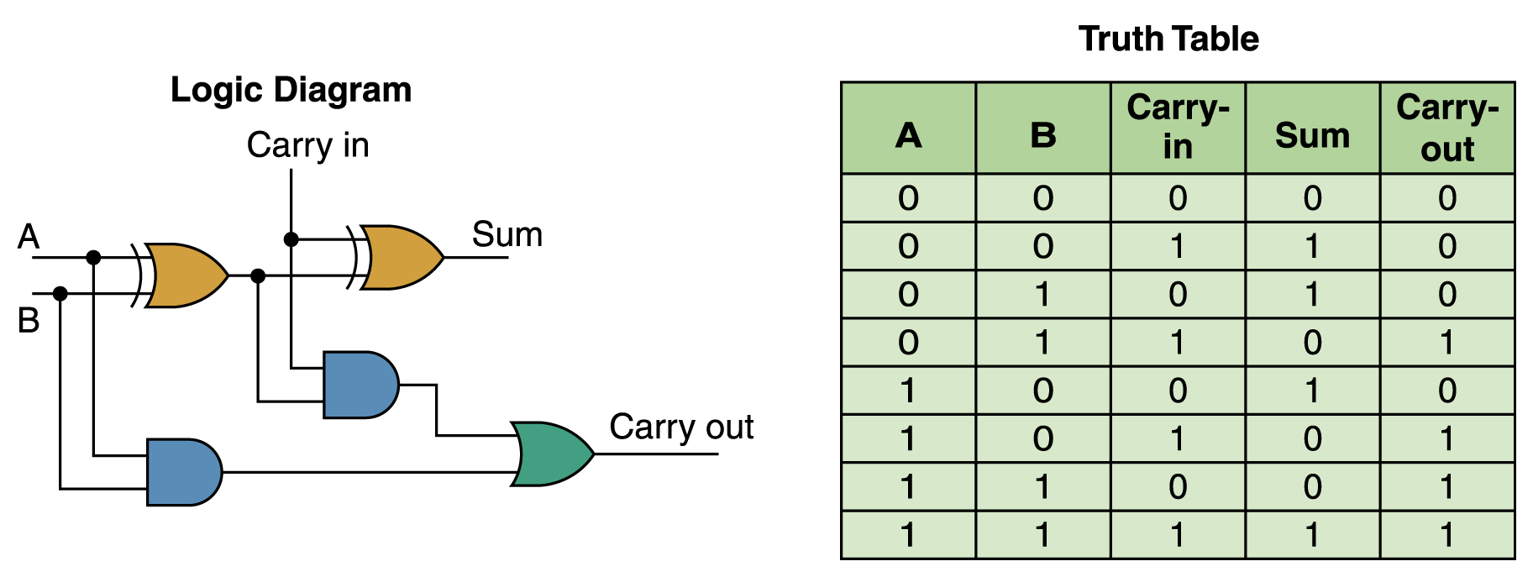
Adders
A circuit called a full adder takes the carry-in value into account

Slide 73
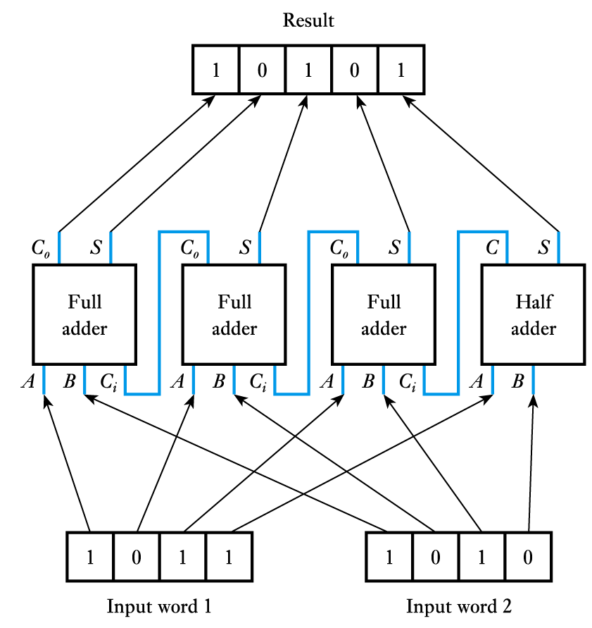
Full Adder
More complex circuits can add digital words
Similar circuits can be constructed to perform subtraction
More complex arithmetic (such as multiplication and division) can be done by dedicated hardware but is more often performed using a microcomputer or complex logic device

Slide 74
Assignment:
Construct a digital circuit that takes a 4-bit binary number as an input and outputs the 2’s complement of the entered number.

